Slide 1
DEPARTMENT
OF
SCIENCE

Slide 2
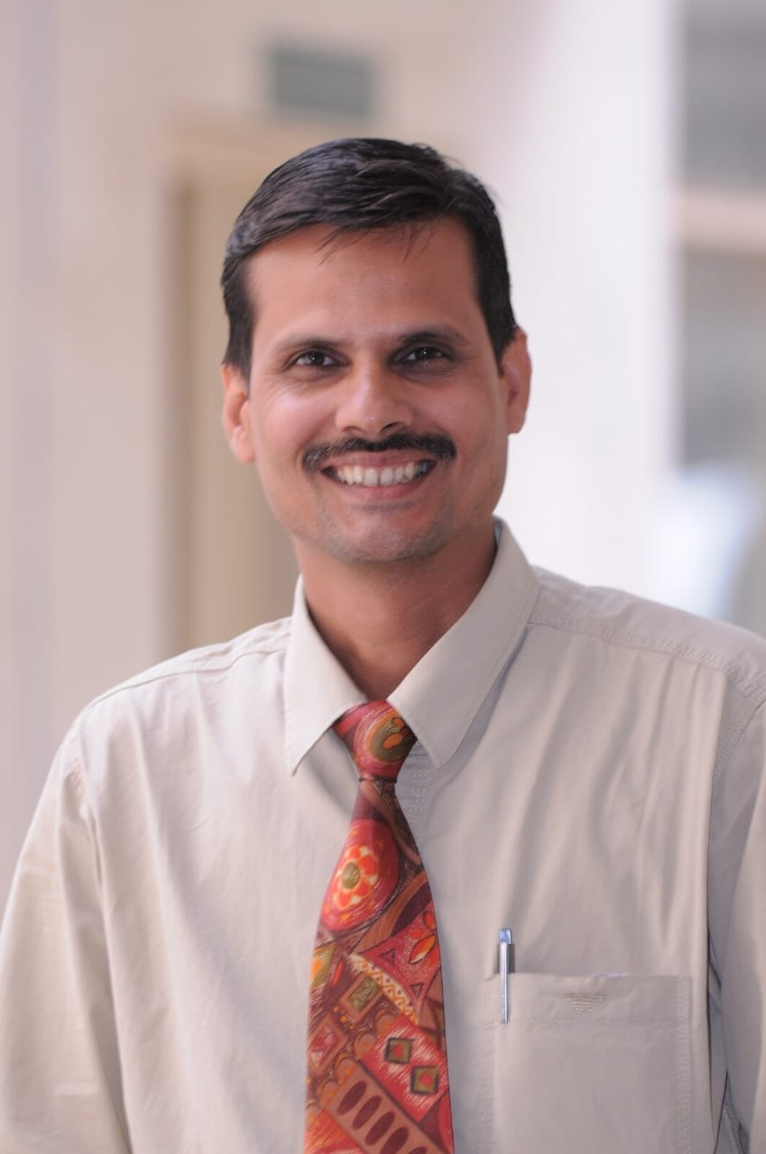
Dr. prafull kumar
Dr. Praful Kumar Vyas

Slide 3
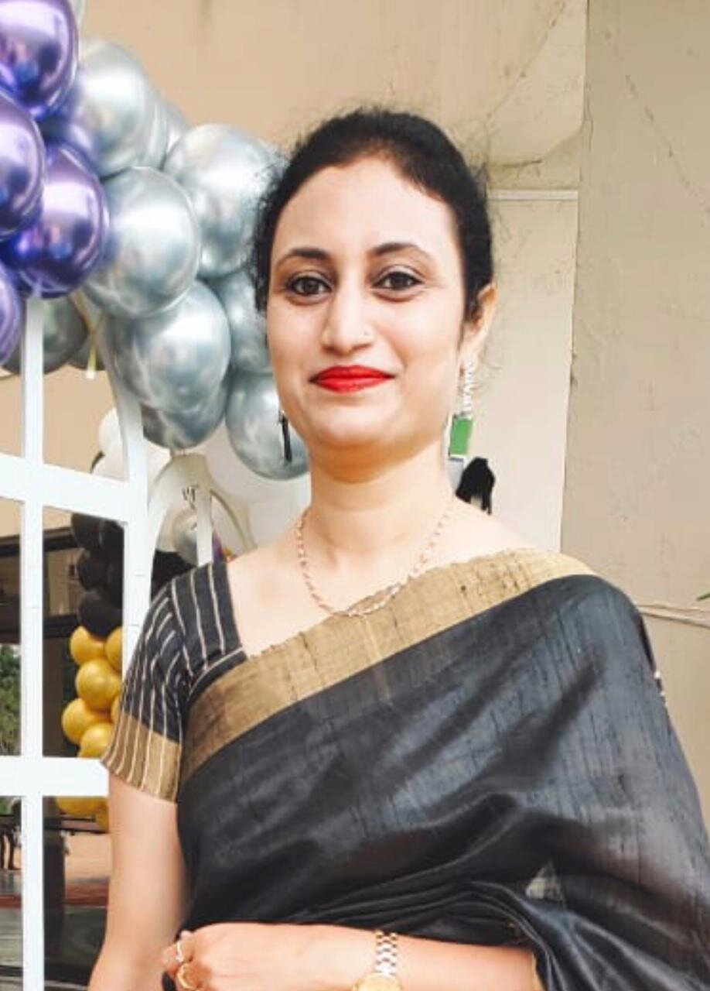
Dr. prafull kumar
Mrs. Naziya Mirza

Slide 4
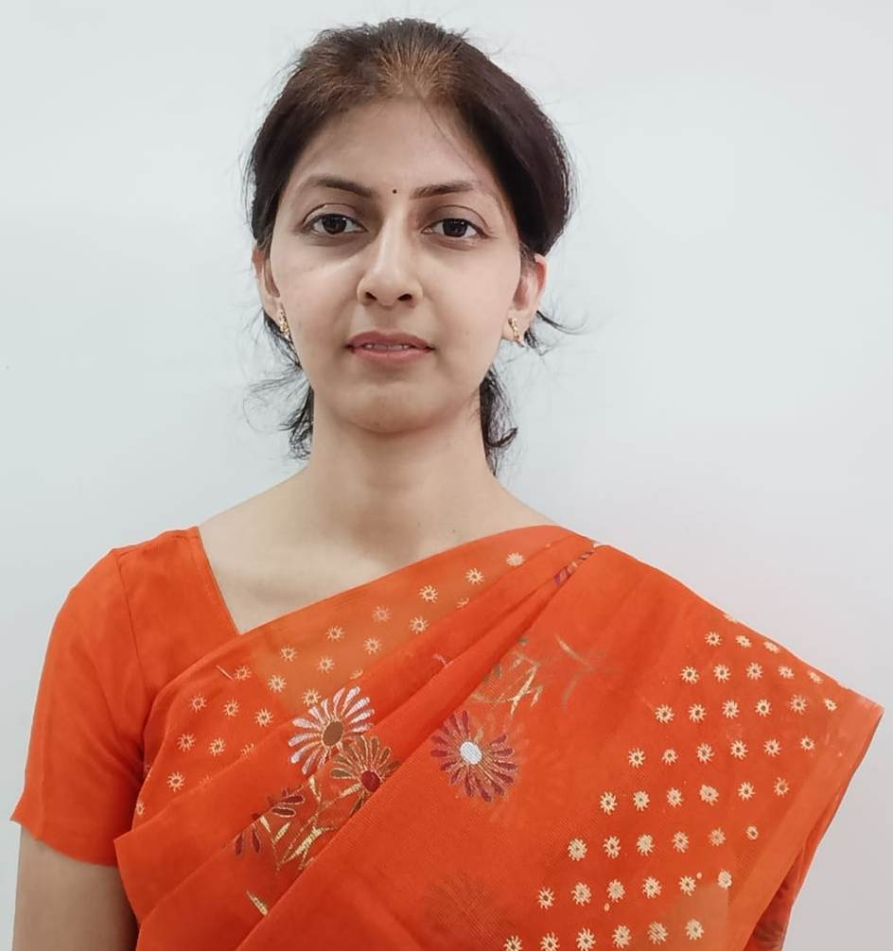
Dr. prafull kumar
Mrs. Richa Gupta

Slide 5
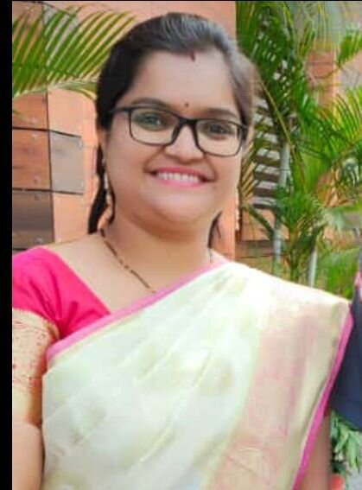
Dr. prafull kumar
Ms. Ketki Parmanand

Slide 6
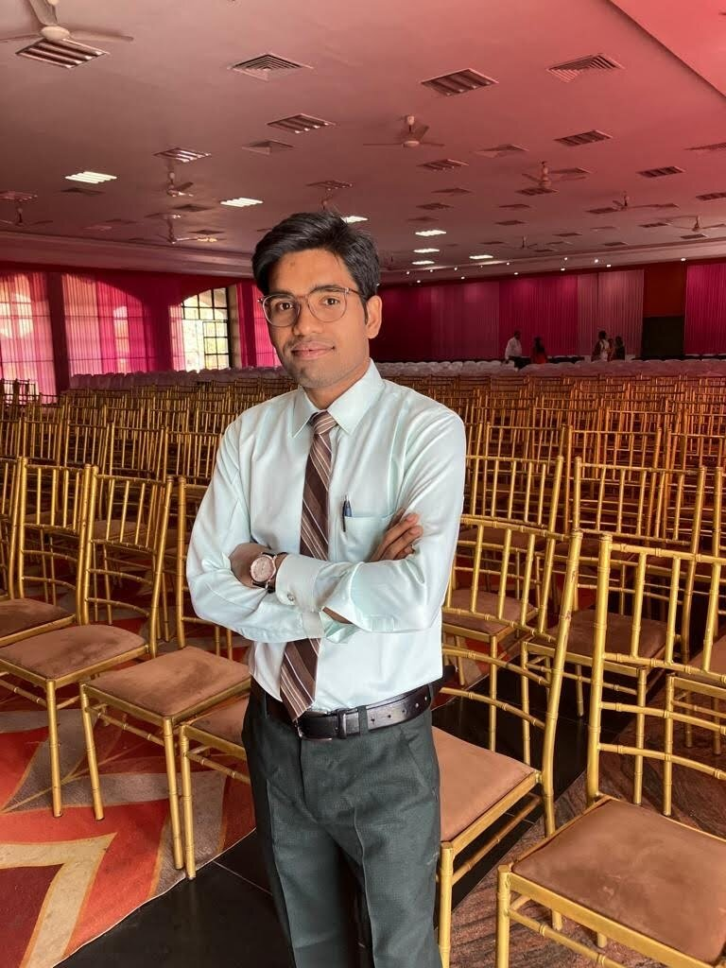
Dr. prafull kumar
Mr. Yogendra Kumar Sao

Slide 7
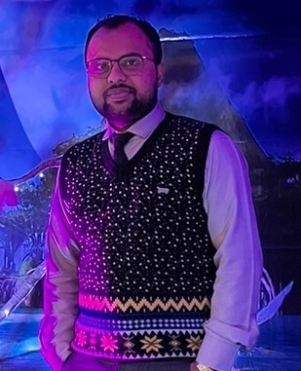
Dr. prafull kumar
Mr. Amit Singh Thakur

Slide 8
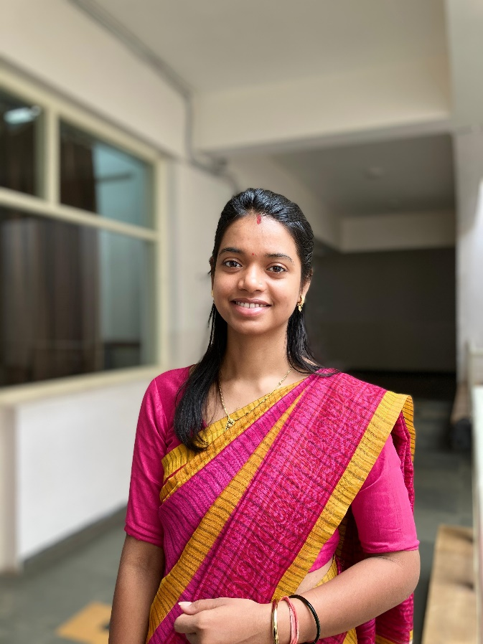
Dr. prafull kumar
Mrs. Anjali Dewangan

Slide 9
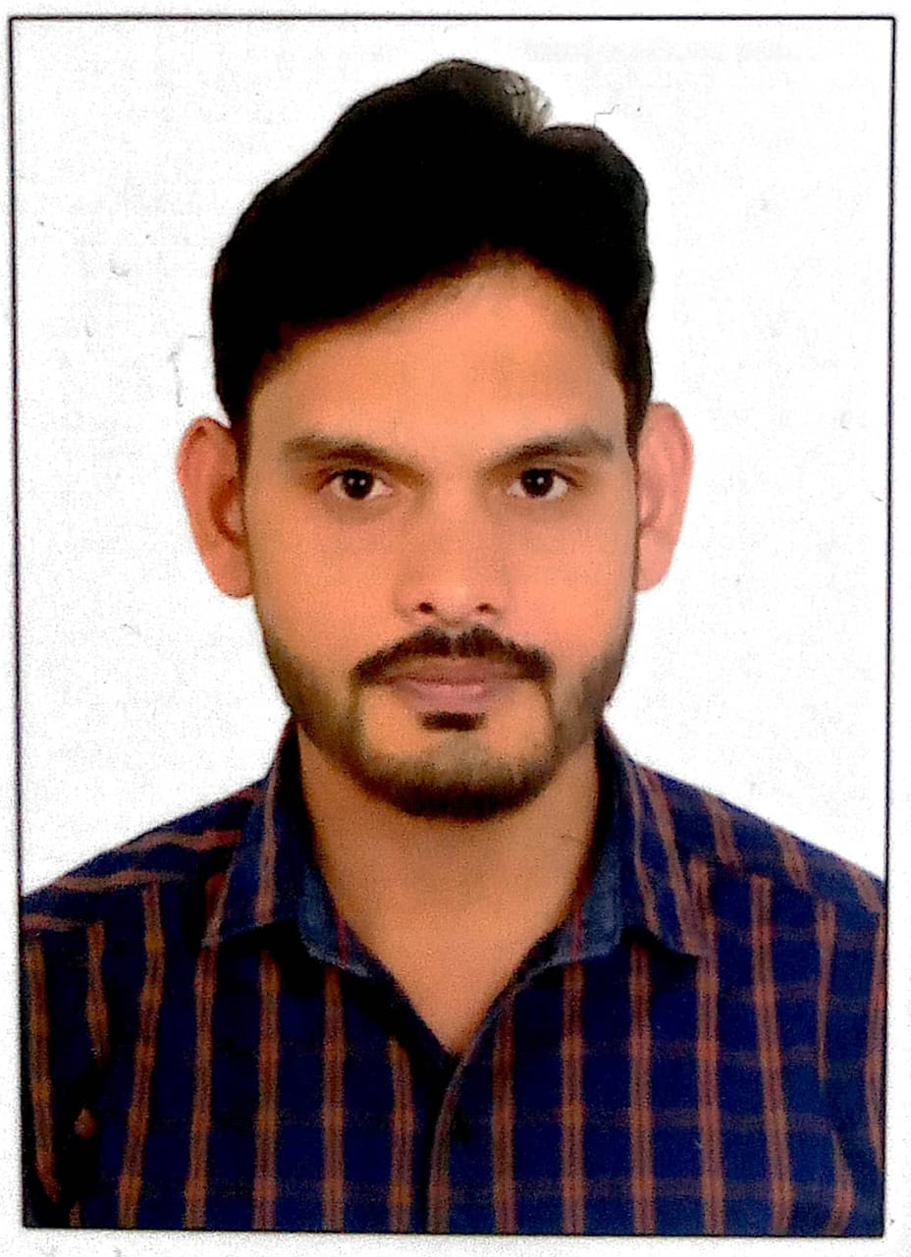
Dr. prafull kumar
Mr. Nilambar Patel

Slide 10
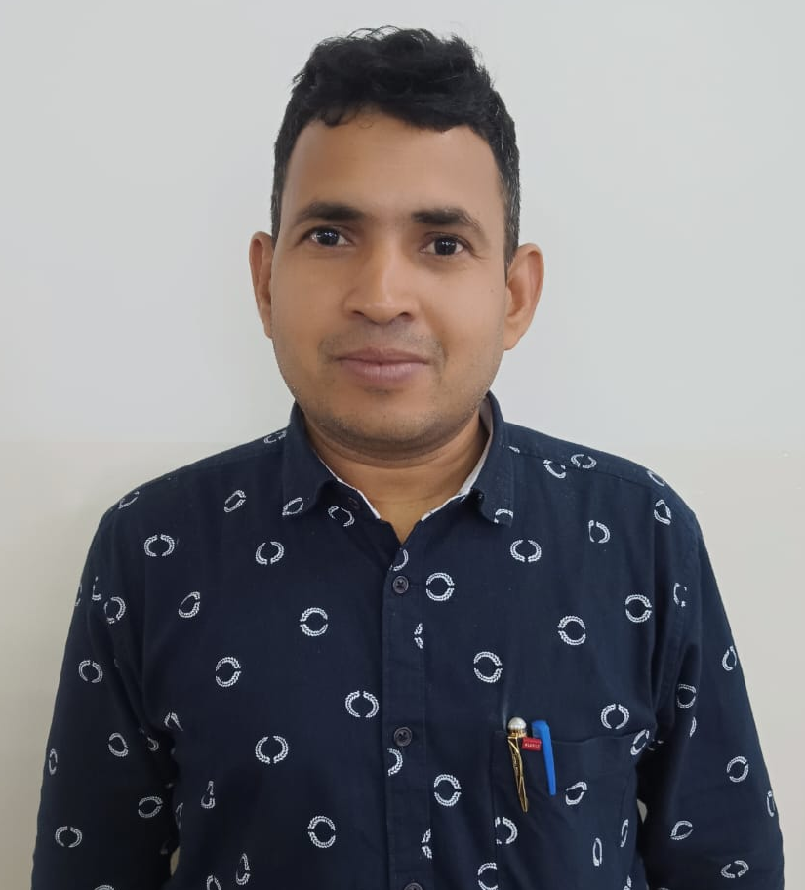
Dr. prafull kumar
Dr. Shiv Kumar Sahoo

